Slide 1
Unit-2 Block Cipher Operation

Slide 2
Block Cipher Operation
Block Cipher:
Encrypt a block of plaintext as a whole to produce same sized cipher text.
Operates on fixed length b-bit input to produce b-bit cipher text.
Eg: DES, AES, 3DES

Slide 3
Modes of operations
Block cipher: Operates on fixed length b-bit input to produce b-bit cipher text.
What about encrypting plaintext longer than b bits?
Break plaintext into b-bit blocks (padding if necessary) and apply cipher on each block
Padding is a way to take data that may or may not be a multiple of the block size for a cipher and extend it out so that it is.
Require the data to be encrypted to be an exact multiple of the block size.
Modes
Electronic Codebook (ECB)
Cipher Block Chaining (CBC)
Cipher Feedback (CFB)
Output Feedback (OFB)
Counter (CTR)
Notes:
enc -des -a -salt –in ct.txt -out cipher.txt
enc -d -des-cbc -a -salt -in cipher.txt -out plain.txt

Slide 4
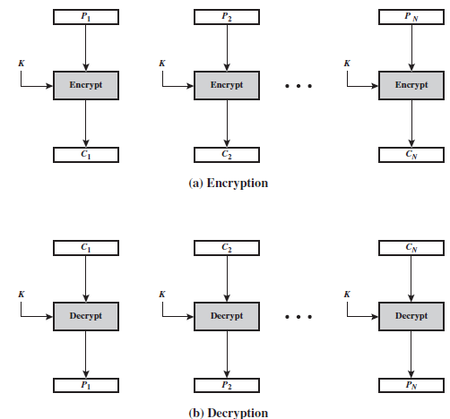
Electronic Codebook (ECB)
Each block of 64 plaintext bits is encrypted independently using the same key.
The ECB method is ideal for a short amount of data, such as an encryption key.
For lengthy messages, the ECB mode may not be secure.
If the message is highly structured, it may be possible for a cryptanalyst to exploit these regularities

Slide 5
Electronic Codebook (ECB)
For a message longer than bits, the procedure is simply to break the message into b-bit blocks, padding the last block if necessary.
Decryption is performed one block at a time, always using the same key.
Plaintext blocks: P1, P2, ….. , PN
Corresponding ciphertext blocks: C1, C2 ….. , CN

Slide 6
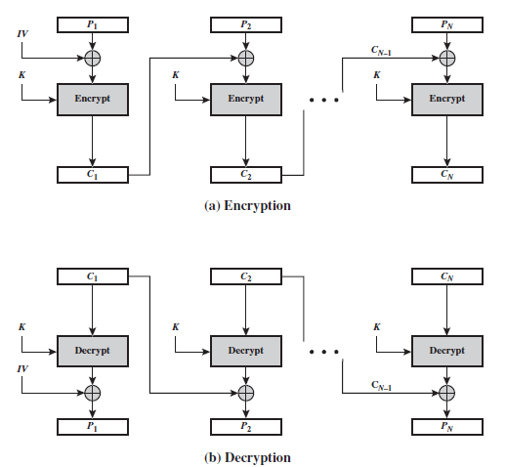
Cipher Block Chaining (CBC)
The input to the encryption algorithm is the XOR of the current plaintext block and the preceding ciphertext block.
The same key is used for each block.
Initialization vector (IV) must be known to both the sender and receiver but be unpredictable by a third party.

Slide 7

Cipher Block Chaining (CBC)

Slide 8
Feedback Mode
It is possible to convert a block cipher into a stream cipher, using one of the three modes:
Cipher Feedback (CFB) mode,
Output Feedback (OFB) mode,
Counter (CTR) mode.
A stream cipher eliminates the need to pad a message to be an integral number of blocks. It also can operate in real time.

Slide 9
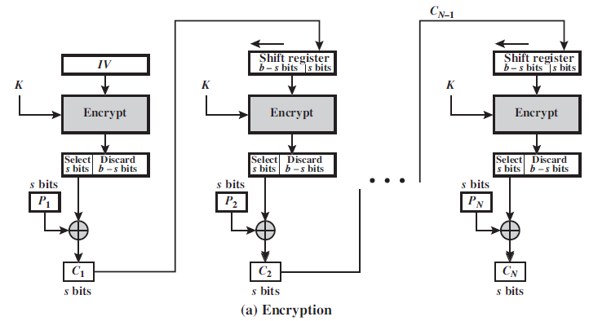
Cipher Feedback Mode (CFB)
The input to the encryption function is a b-bit shift register that is initially set to some initialization vector (IV).
The contents of the shift register are shifted left by bits
General-purpose stream oriented transmission

Slide 10

Cipher Feedback Mode (CFB)
Encryption
s=8 bits
b=64 bits
B-s=64-8=56 bits

Slide 11
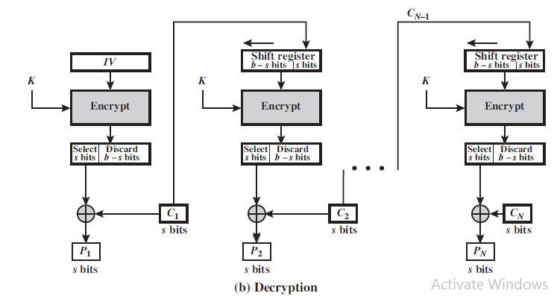

Cipher Feedback Mode (CFB)
Decryption
Notes:
initialization vector is, in its broadest sense, just the initial value used to start some iterated process

Slide 12
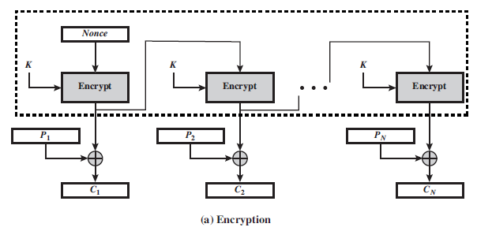
Output feedback (OFB) mode
The output feedback (OFB) mode is similar in structure to that of CFB
Differences b/w CFB and OFB
The output of the encryption function that is fed back to the shift register in OFB, whereas in CFB, the ciphertext unit is fed back to the shift register.
The other difference is that the OFB mode operates on full blocks of plaintext and ciphertext, not on an s-bit subset.
Encryption:

Slide 13
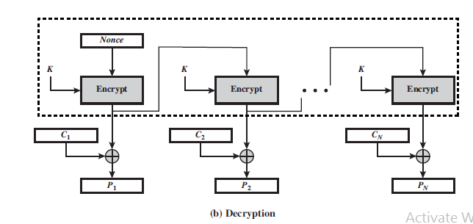

Output feedback (OFB) mode
The output feedback (OFB) mode is similar in structure to that of CFB
Differences b/w CFB and OFB
The output of the encryption function that is fed back to the shift register in OFB, whereas in CFB, the ciphertext unit is fed back to the shift register.
The other difference is that the OFB mode operates on full blocks of plaintext and ciphertext, not on an s-bit subset.
Decryption:

Slide 14
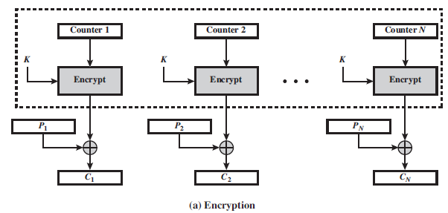
Counter (CTR) mode
A counter equal to the plaintext block size is used.
Typically, the counter is initialized to some value and then incremented by 1 for each subsequent block.
Given a sequence of counters T1, T2, …… , TN, we can define CTR mode as follows.
Encryption:

Slide 15
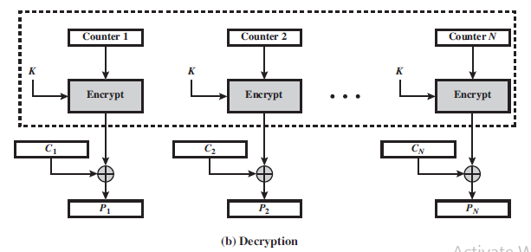
Counter (CTR) mode
Decryption:

Slide 16
Number Theory
Prime numbers:
Prime numbers play an critical role both in number theory and in cryptography.
An important requirement in a number of cryptographic algorithms is the ability to choose a large prime number.
Two theorems that play important roles in public-key cryptography are
Fermat’s theorem and Euler’s theorem.

Slide 17




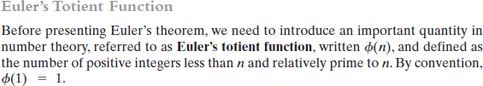




Slide 18
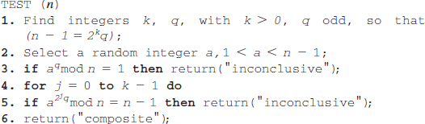
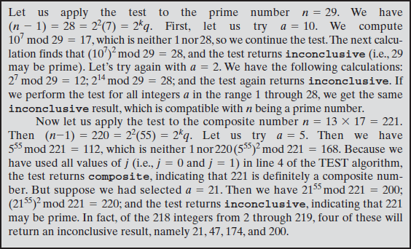
TESTING FOR PRIMALITY
Miller-Rabin Algorithm
Notes:
φφ

